Slide 1
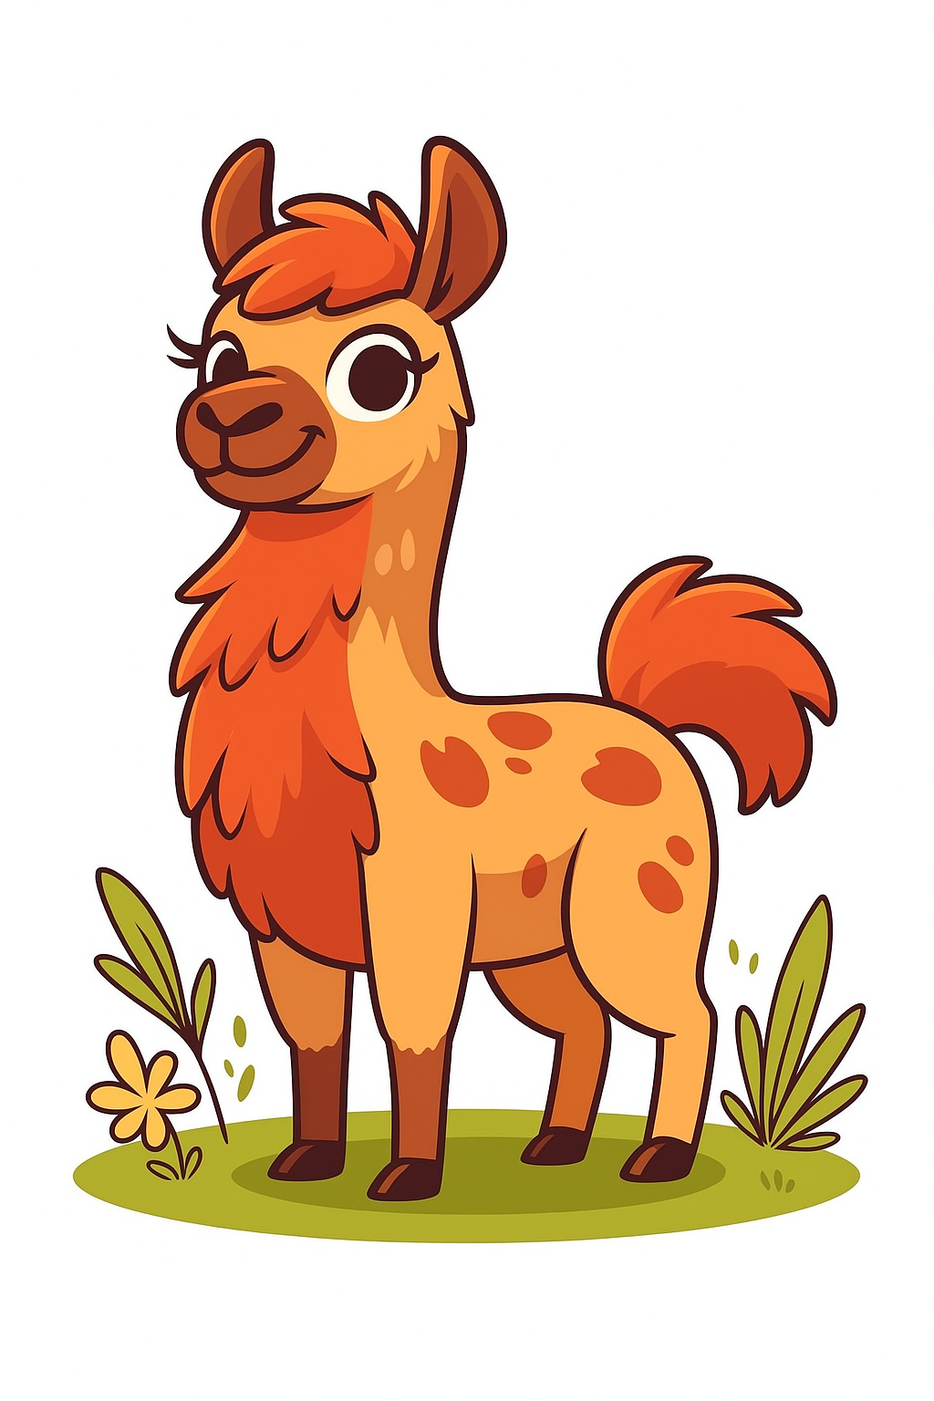
Attention
This might hurt a little...
0
Hardware
1
1
Tokenization
2
2
Embeddings
3
3
Attention
0

Slide 2
Attention
Think about these two sentences:
"the old ragdoll cat was [?]"
"the young tonkinese cat was [?]"
What do you think is important information about determining the missing word?

Slide 3
Attention
Let's just focus on adjectives...
...which words modify cat?
Suppose we have an embedding of cat:
"cat" g [1, 2, 3, 4]
→

Slide 4
Attention
Each token in our sentence:
"the old ragdoll cat was [?]"
will have one of these vectors
We call the vector for cat x, and the matrix for the sentence X
→

Slide 5
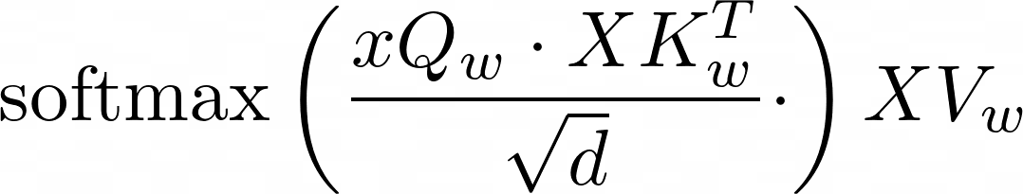
Attention
The contextual representation of cat is then:

Slide 6
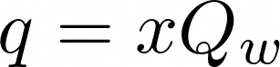
Query
"cat" g [0.134, -0.782, -0.021, 0.459]
"Which of you other tokens modifies me?"
(1, 4)
(4, d_{q})
(1, d_{q})

Slide 7
Attention
The contextual representation of cat is then:

Slide 8
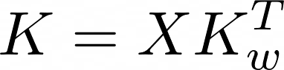
Keys
"I can provide this information!"
(5, 4)
(5, d_{k})
(4, d_{k})

Slide 9
Attention
The contextual representation of cat is then:

Slide 10
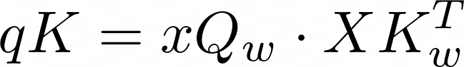
Queries and keys
"Does the information that you provide, match my question?"

Slide 11
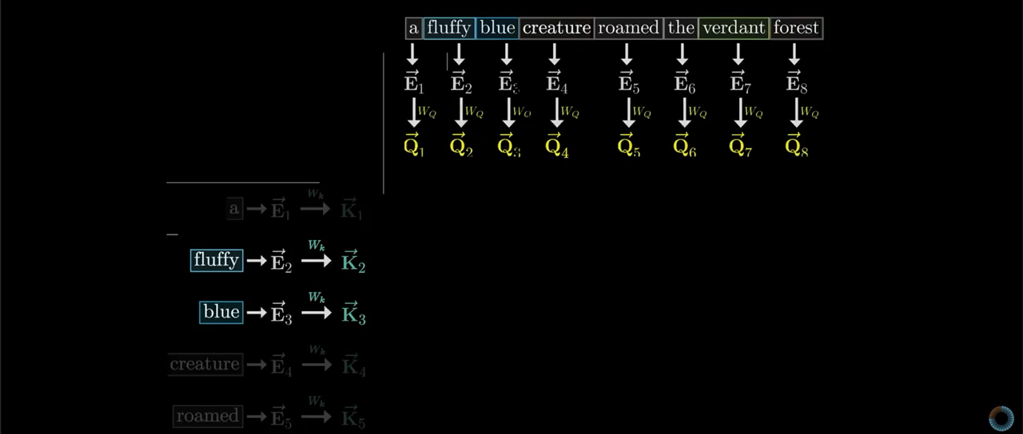
Queries and keys

Slide 12
Attention
The contextual representation of cat is then:
This is for scaling

Slide 13
Attention
The contextual representation of cat is then:

Slide 14
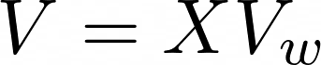
Values
"How do I modify the original concept, to get to the new concept?"
(5, 4)
(5, d_{v})
(4, d_{v})

Slide 15
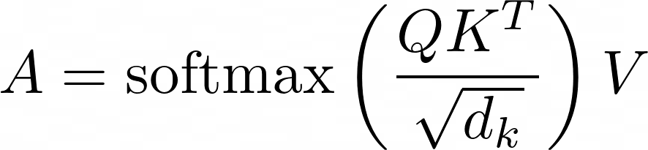
Attention
Generally, we just act on all parts of the sentence at once:

Slide 16
Attention
We have been using the idea of looking for adjective that modify cat
This is one question, and one head
We want to ask multiple questions!

Slide 17

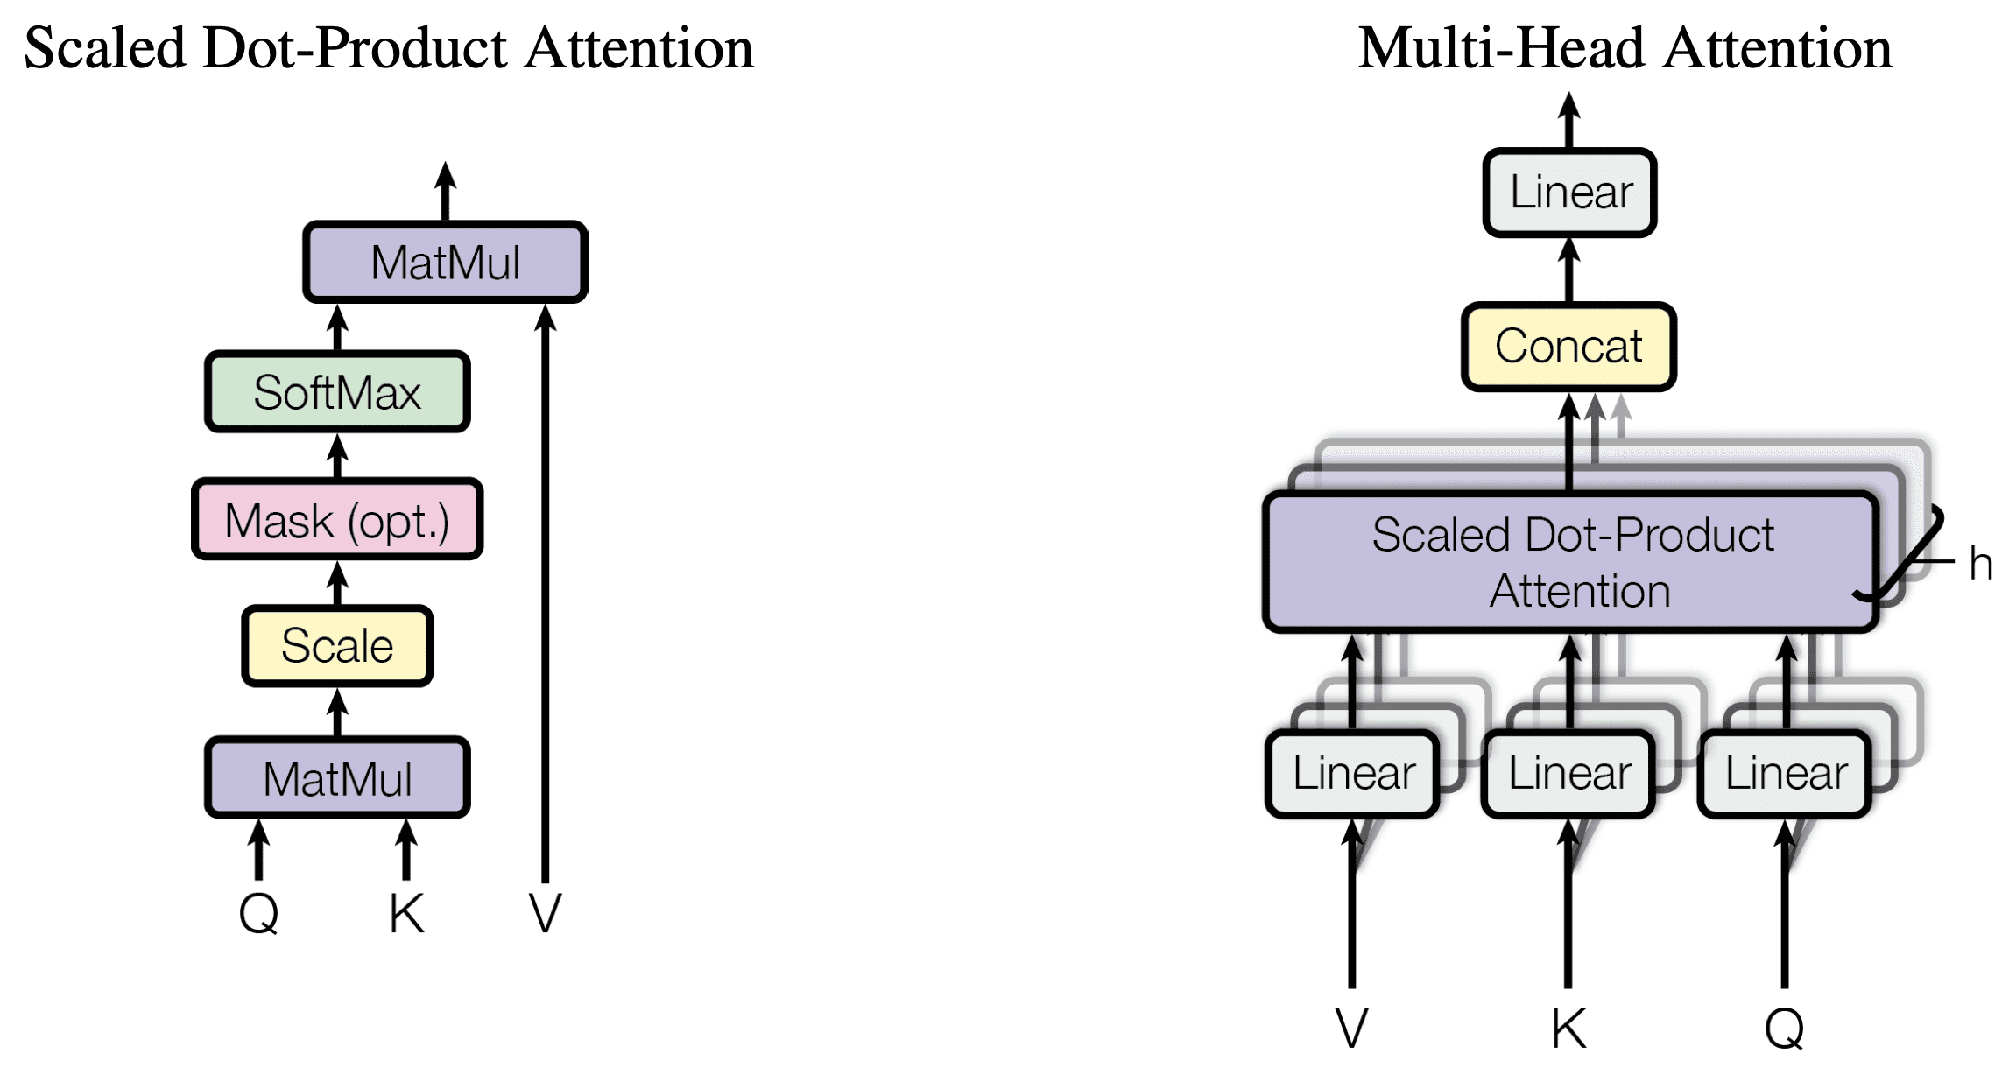
Multi-headed attention

Slide 18
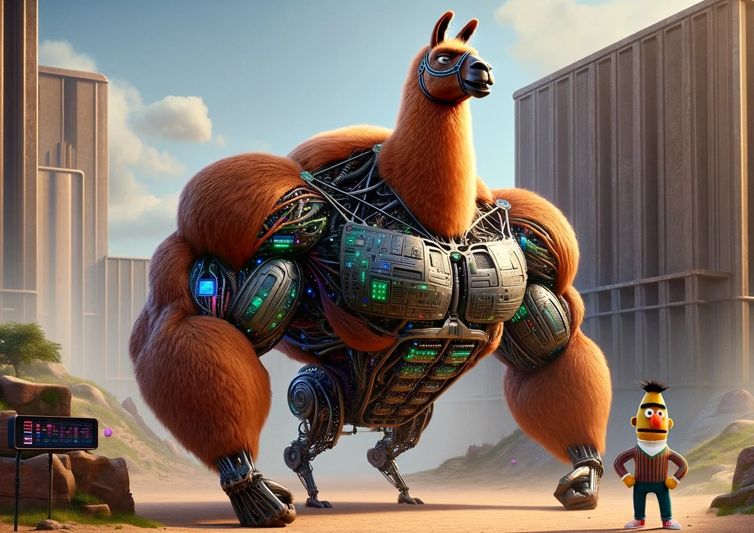
Two types of models

Slide 19
Two types of models
Generative
Autoregressive
Next-token prediction
Discriminative
Context aware
Masked-token prediction

Slide 20
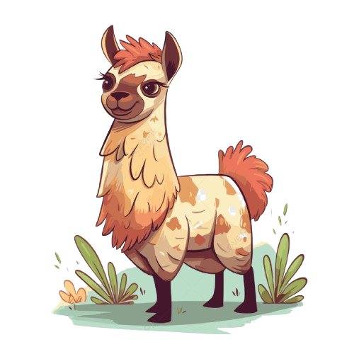
Large Language Model Meta AI
‘<bos>’’
‘the’
‘cat’
‘sat
‘on’
‘the’
‘mat’
‘<eos>’
101
1996
4937
6583
2006
1996
13523
102
‘the’
‘cat’
‘sat’
‘on’
‘the’
‘mat’
‘mat’ | 0.19
‘dog’ | 0.14
‘hippo’ | 0.07
‘was’ | 0.000001
Notes:
ChatGPT and other “generative” models, are next token predictors. In other words, given some input tokens for example, “The cat sat on the”, then what is the next token. We’ll come back to this later.

Slide 21
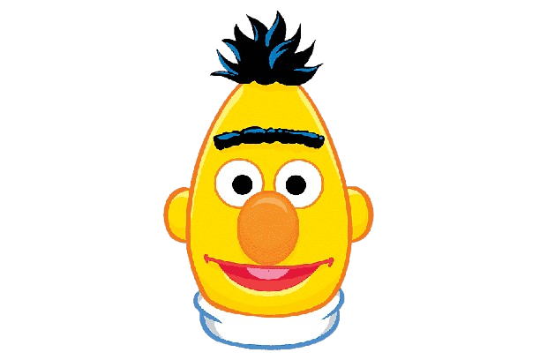
Bidirectional Encoder Representations from Transformers
‘[CLS]’
‘the’
‘cat’
‘[MASK]’
‘on’
‘the’
‘mat’
‘[SEP]’
101
1996
4937
103
2006
1996
13523
102
‘the’
‘cat’
‘sat’
‘on’
‘the’
‘mat’
‘sat’ | 0.19
‘was’ | 0.14
‘lay’ | 0.07
‘hippo’ | 0.000001
Notes:
BERT is what we call a masked token predictor. Here we have the same example. Except this time, we have masked the token “sat”. The job for bert is to predict this masked token. You see on the right, lots of different options. BERT will actually predict the probability of every possible token being the next token. So let’s say each token is a word, and suppose there are 200,000 words to choose from, then you’ll end up with 200,000 numbers. And the biggest number is the most likely next token. We’ll come back to this right hand side. But first I want to look at what’s going on in the left hand side.

